Slide 1
CyberCane
Assistive technology, smarter.

Slide 2
Setting the scene: White cane statistics
2-8% of VI use canes
Increasing health issues
Uncorrectable VI:
2012: 4.2 million Americans 40 and older
2050: 8.96 million projected

Slide 3

Mission statement:
To assist those who are visually impaired through advanced and innovative technology

Slide 4
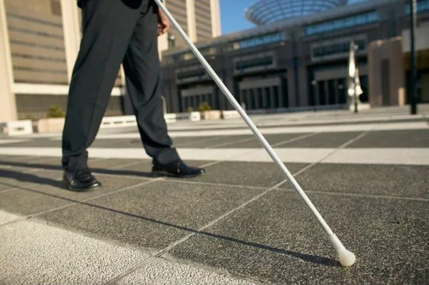
Current Market Place
White Canes
Advantages
Mobility
Visibility
Disadvantages
Durability
Portability
Uncreative Design
Difficult to use

Slide 5
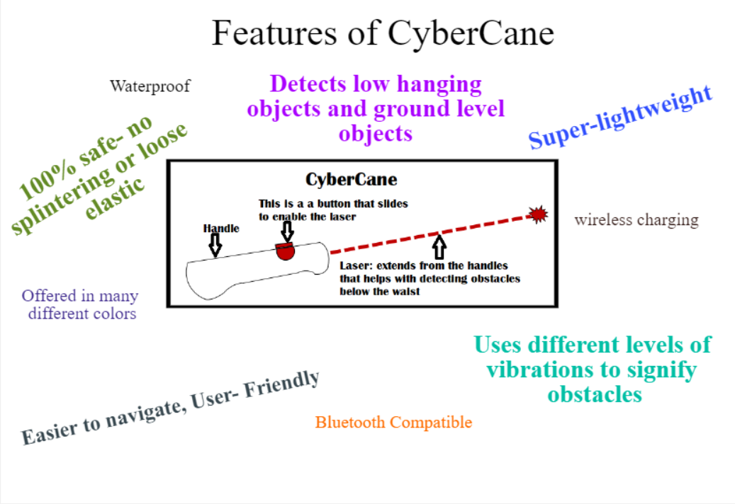
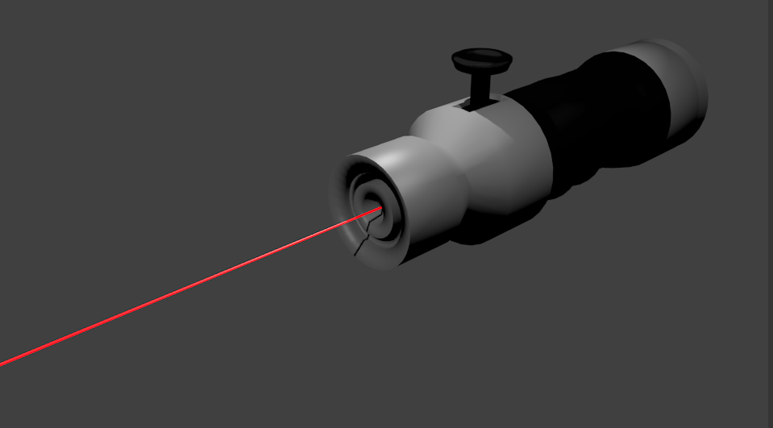

Slide 6
How it works: Capturing our segments
Step 2
Step 3
Step 1
Based on the tests, cane is recommended to optometrists and other health professionals for distribution and credible recommendations to customers
CyberCane is also sold online, with the advantage of being able to pay in installments (interest included)
A limited number of canes are given out to schools and learning centers for those who are VI to test

Slide 7

The technology:
Laser, bluetooth, GPS

Slide 8
Building Blocks
Engineers
Superior product functionality
IT support
Customer service
Researchers
Competitive technology
There are three main components that are critical to our team and value proposition.

